Slide 1
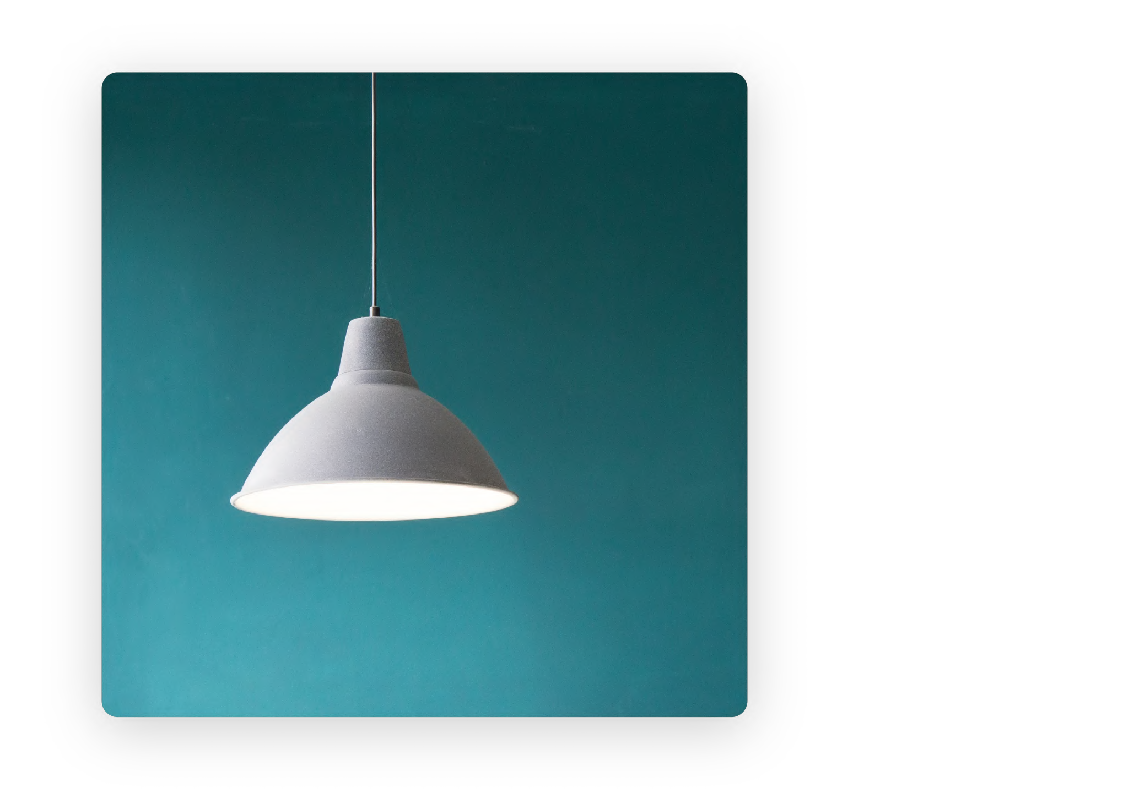
FACEBOOK BUYER CASE STUDY

Slide 2
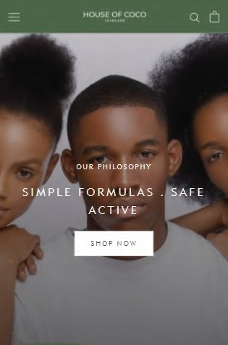
Case study — House of Coco
House of Coco is a Nigerian skincare brand targeting women within the ages of 24 and 38. In 2021, Chidiogo, the founder, approached me keen to completely pivot to an online business model - no physical stores. Although they had a website, it only accounted for 8% of total sales.
_{64%} increase in sales in the
first month
3.5%
Average click-through- rate from ad creatives
I proposed a short term but aggressive conversions campaign to initially drive sales, but more importantly, to collect data. This involved running paid ad campaign on Facebook using different objectives like traffic, messaging and conversion ads.
_{5X} More orders than previous 6 months

Slide 3
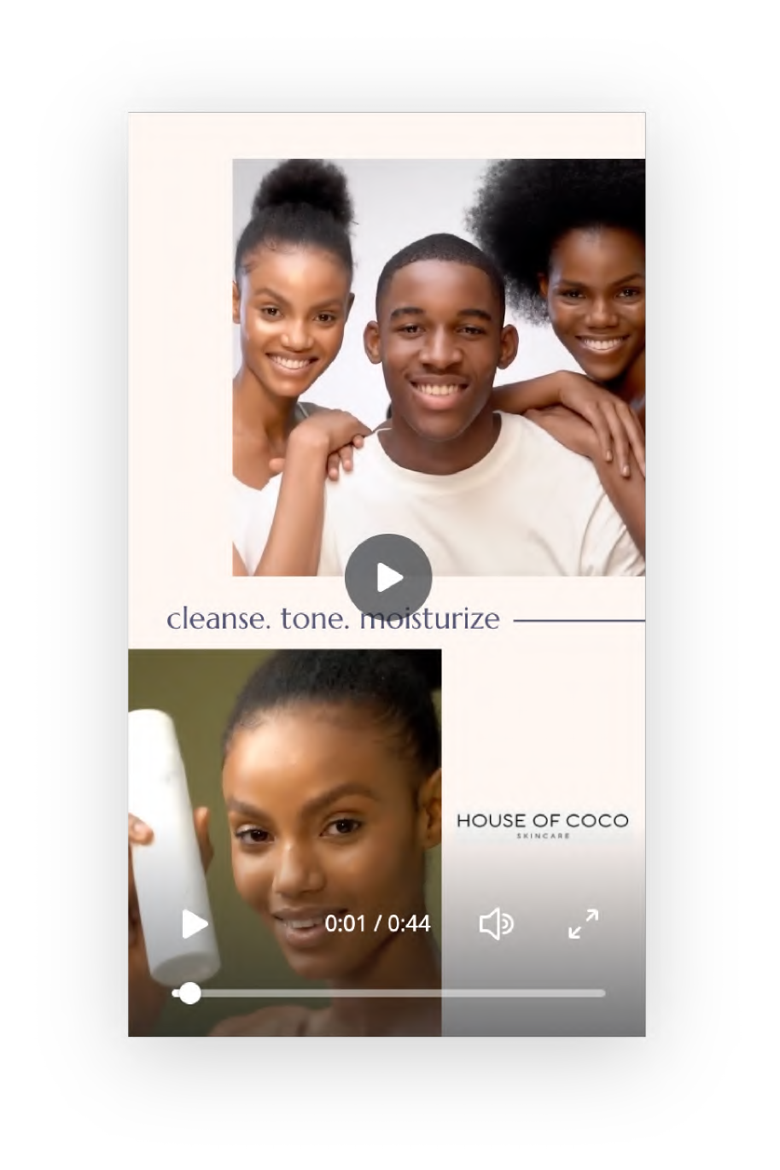
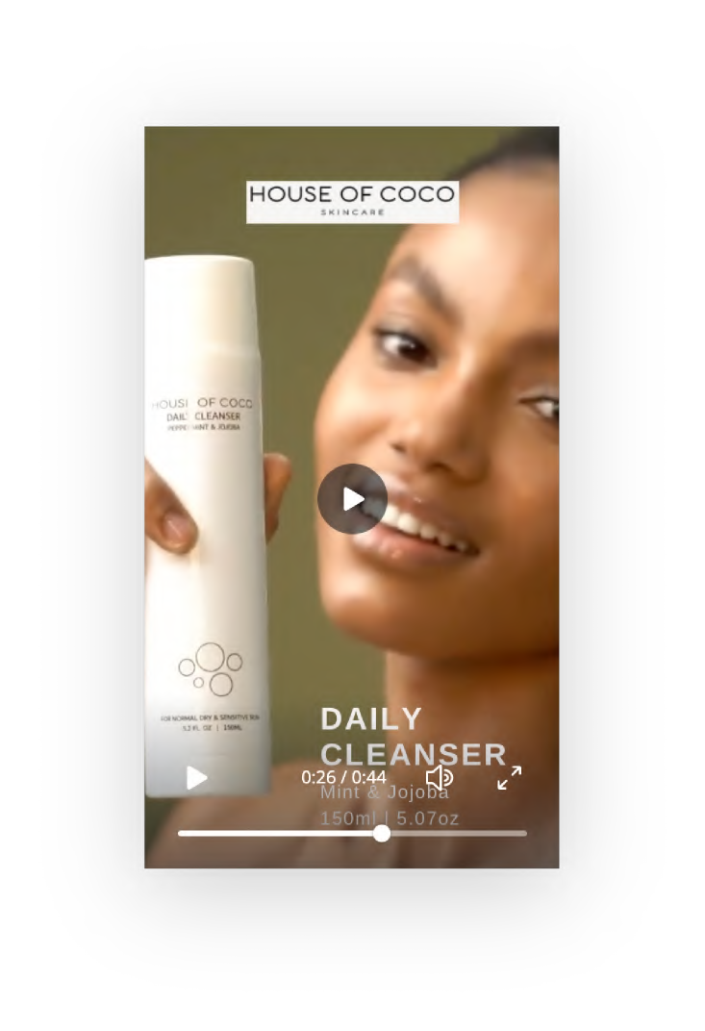
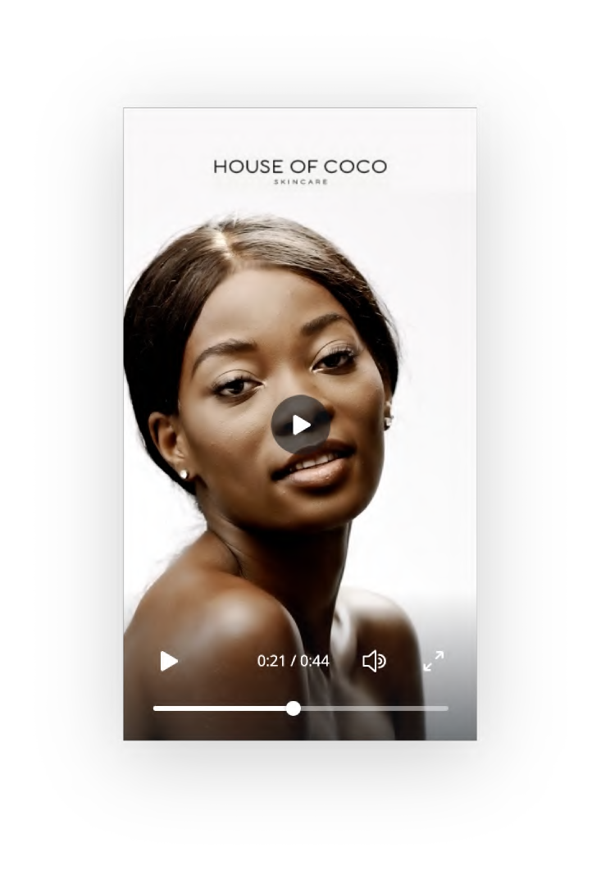
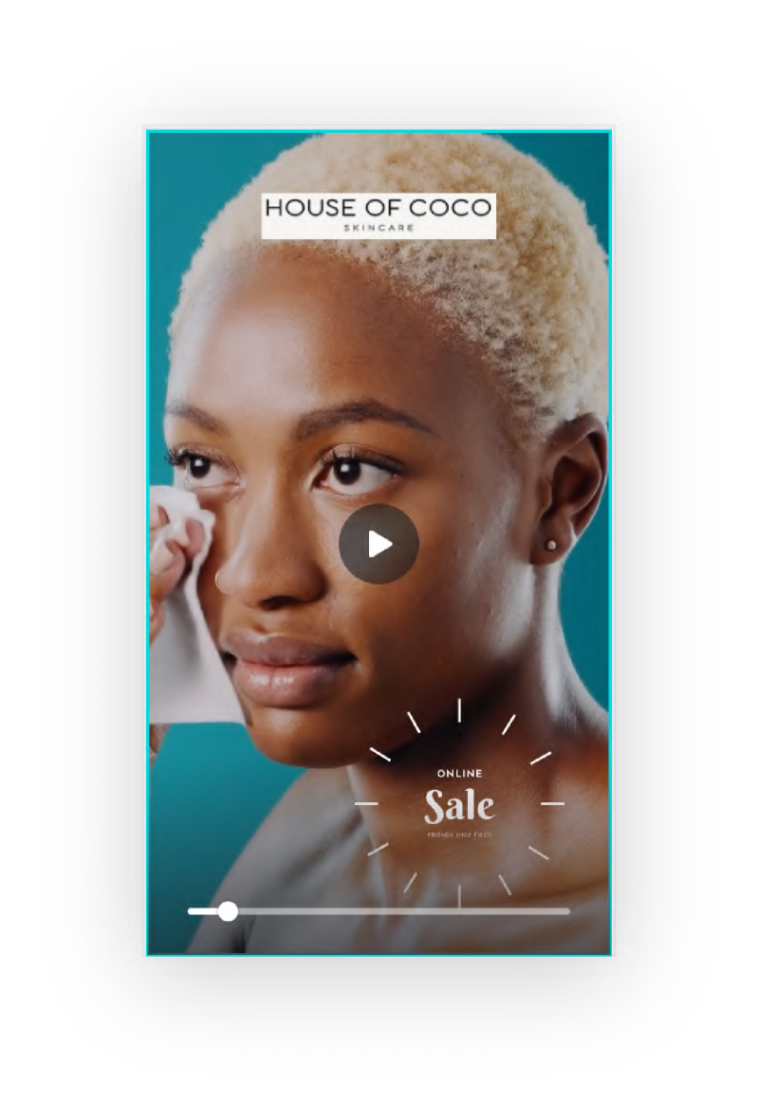
Case study — House of Coco
Goal: Establish a strong brand image
Enhance with Motion Keep Attention with Speed Begin with your brand Create for Stories first
Test mobile-shot for brand objectives
Up to 20 ad creative assets over the next 6 months
60% brand emphasis (logo, message; KPI: ad recall and brand awareness)
40% product emphasis (promotions, catalogue; KPI: purchase intent)

Slide 4
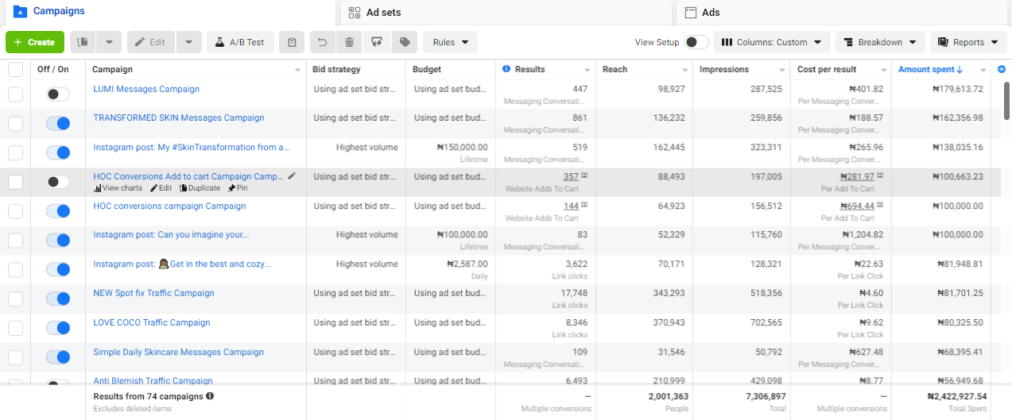
Case study — House of Coco

Slide 5
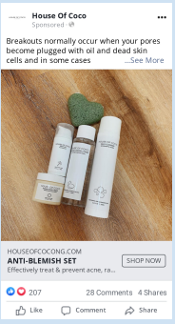
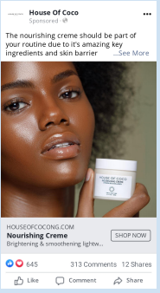
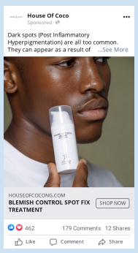
Case study — House of Coco
Codematic Technology Services

Slide 6
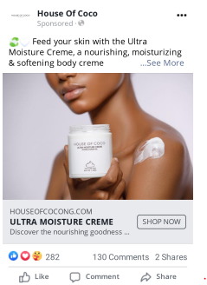
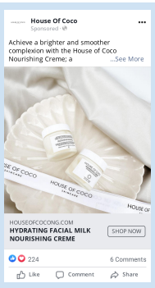
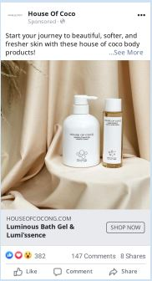
Case study — House of Coco
Codematic Technology Services

Slide 7
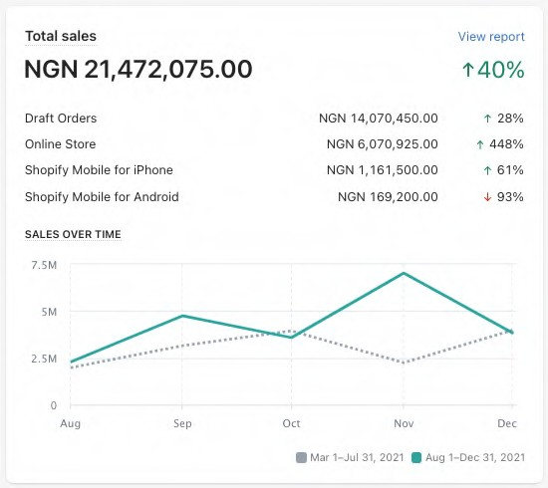
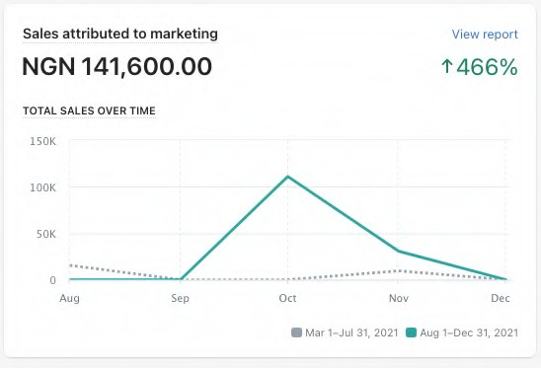
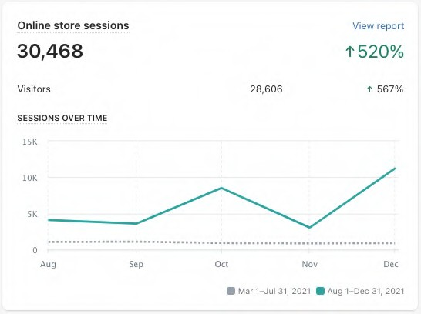
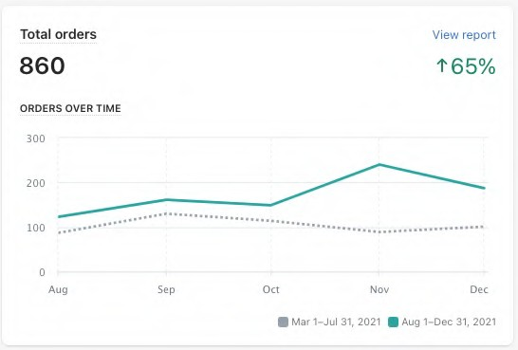
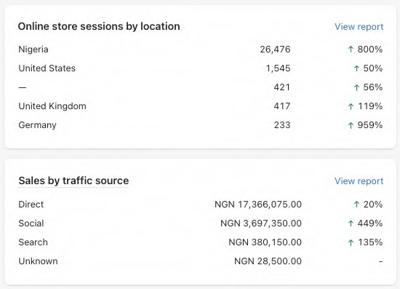
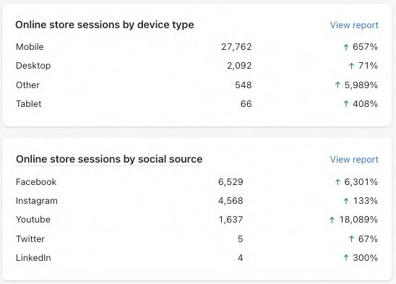
CASE STUDY
Action Plan
?
?
?
?
?
?
?
?

Slide 8
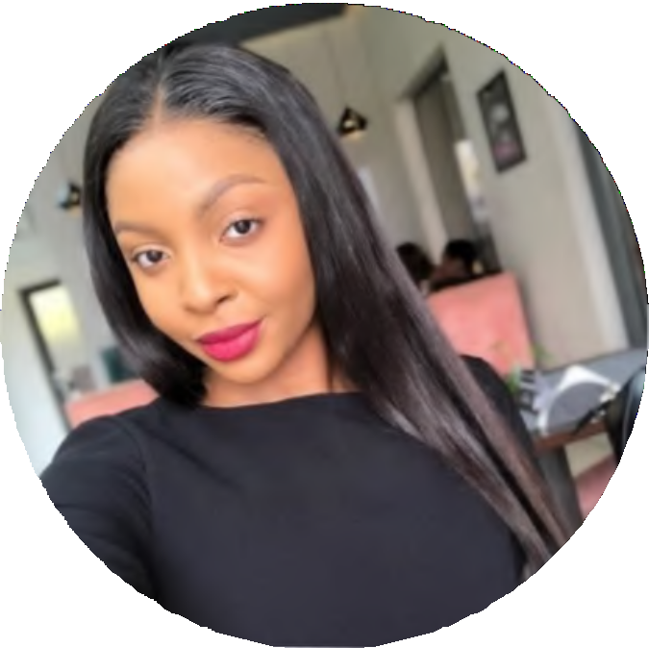
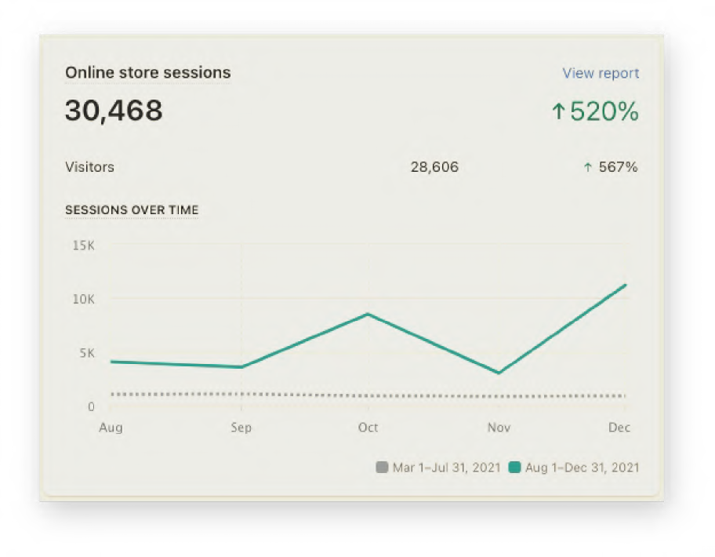
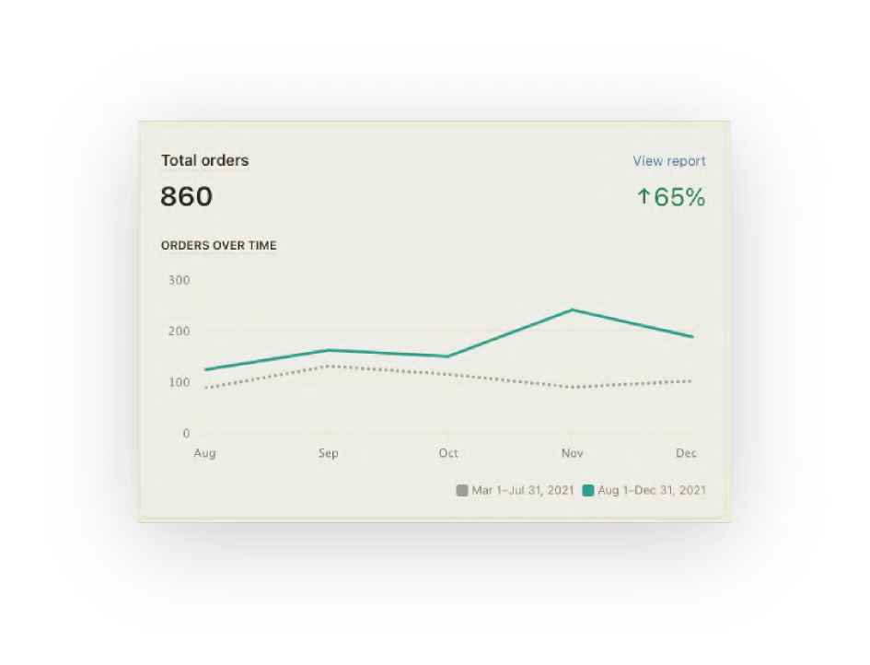
Case study — I n Chidiogo's words
"This project has helped my company grow in more ways than I'd anticipated. We were able to achieve our yearly growth goals in just four months."
"Siji is actually consultative, and not just prescriptive like most other Facebook ad buyers I've dealt with. I really couldn't recommend Siji enough!"
Chidiogo Mbelede
CEO at House of Coco NG

Slide 9
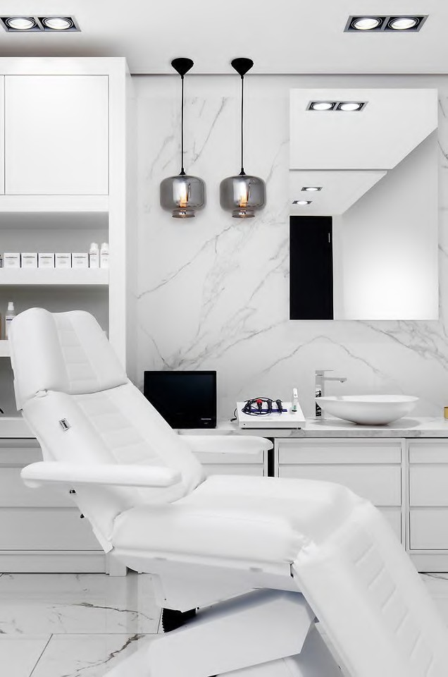
Case study — Ale Beaute
As an expanding beauty clinic, Alé Beaute was looking to reduce its reliance on word-of-mouth referrals and ad-hoc bouts of influencer marketing campaigns for its teeth whitening service bookings in Lekki, Lagos.
They were keener on growing sustainably due to increased brand awareness and online presence.
65%
increase in sales in the first month
3.3%
Average click-through- rate from ad creatives
I helped Ale Beaute establish a reliable data- capturing system by setting up their Facebook API & Pixel to collect high-quality data directly from their bookings site. I also worked with Ale Beaute to craft compelling ad creatives and content that instantly caught the target audience's attention.
3.5x
More bookings than previous year

Slide 10
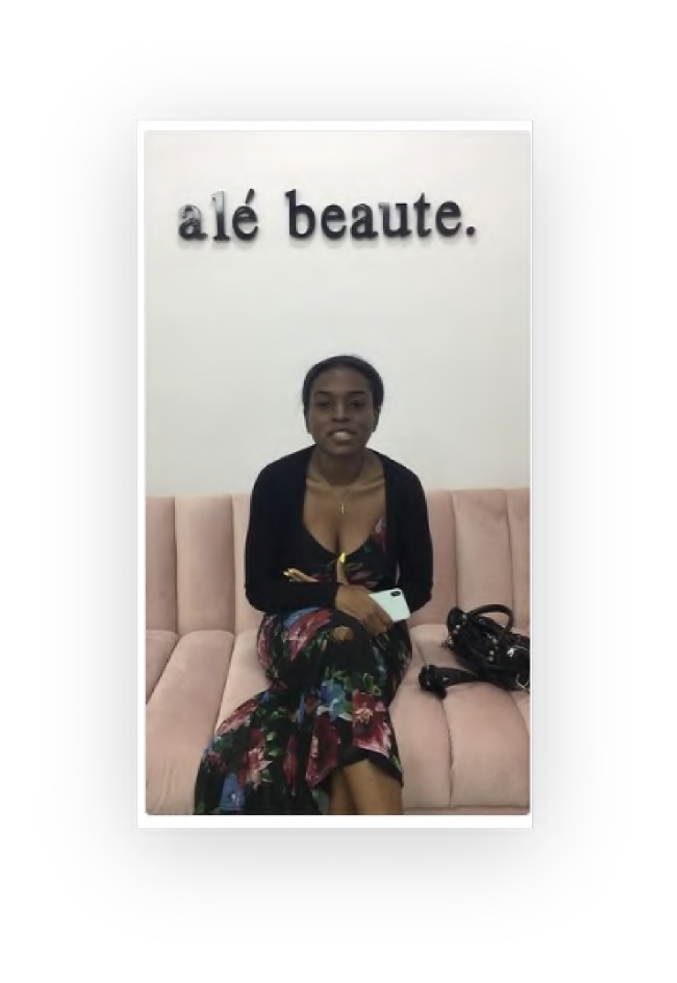
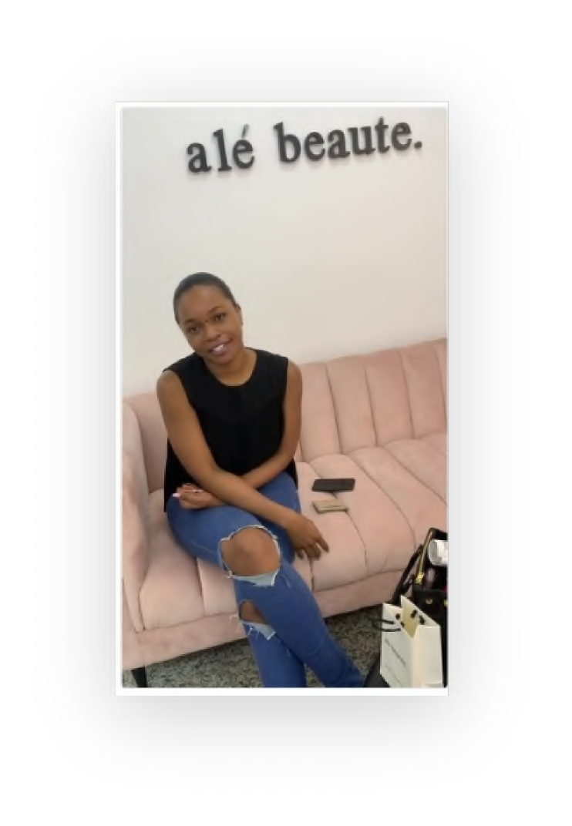
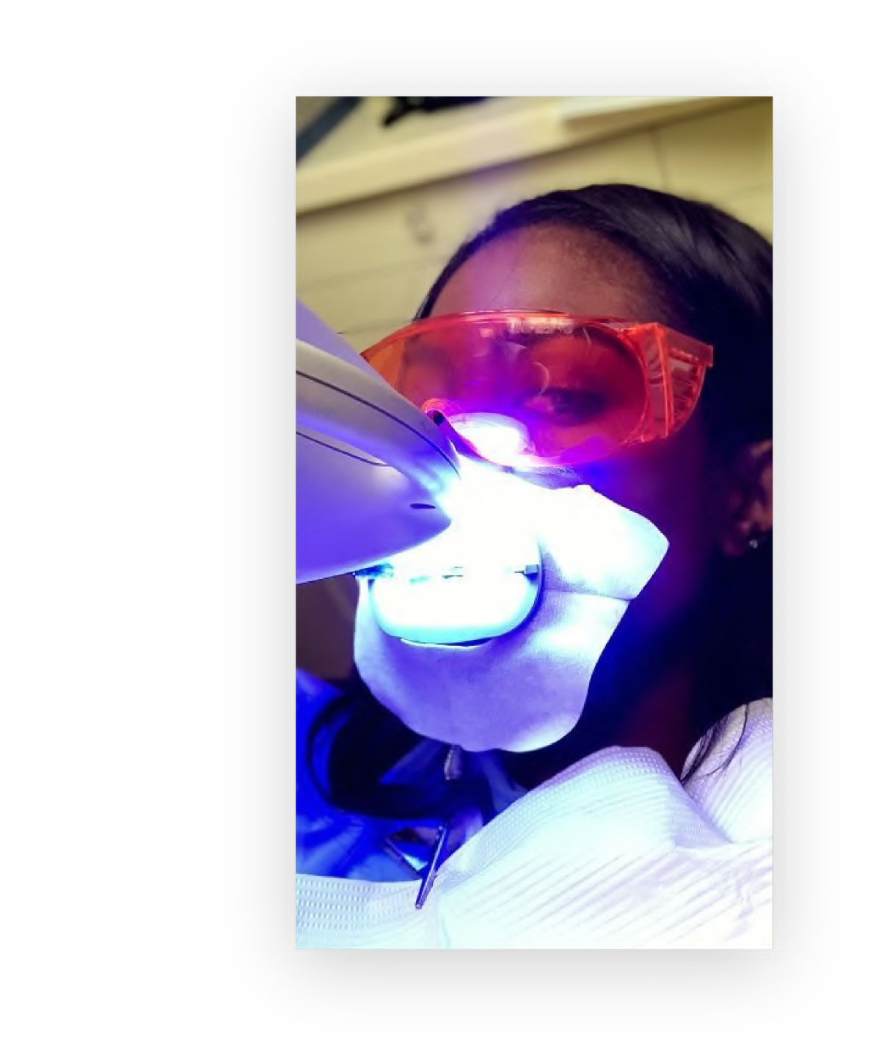
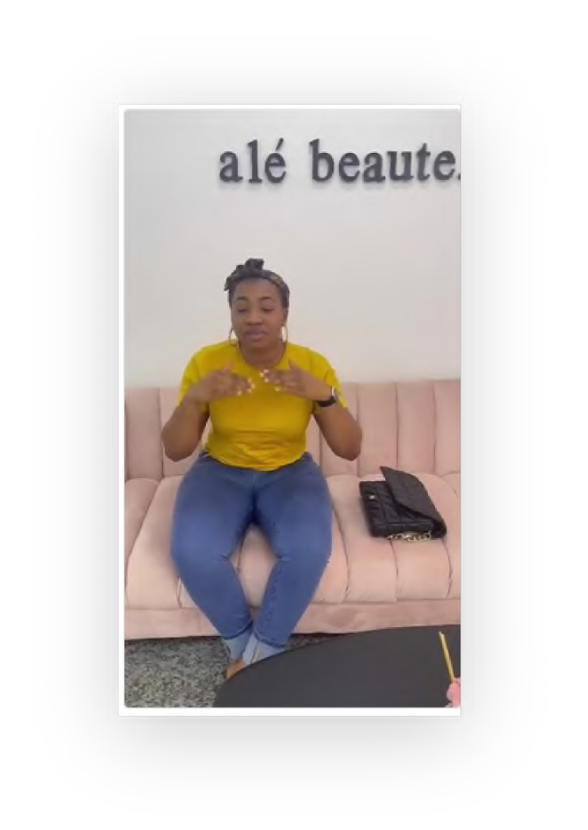
Case study — Ale Beaute
Goal: Increase average monthly bookings
Build trust with the target audience
Portray Ale Beaute as experts & industry leaders Establish data capture system for effective targeting Reduce Cost Per Link Click with effective retargeting Create for Stories first
Appear in top 5 results for teeth whitening in Lagos
Creatively use customer testimonials in ads targeted at women aged 24 - 35 in Lagos.
Use existing customer data to build lookalike and custom audiences

Slide 11
Thank you

